Slide 1
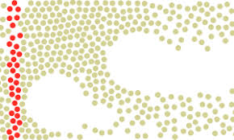
Boundary Trajectory Clustering (Pickpockets recognition, remember?)

Slide 2
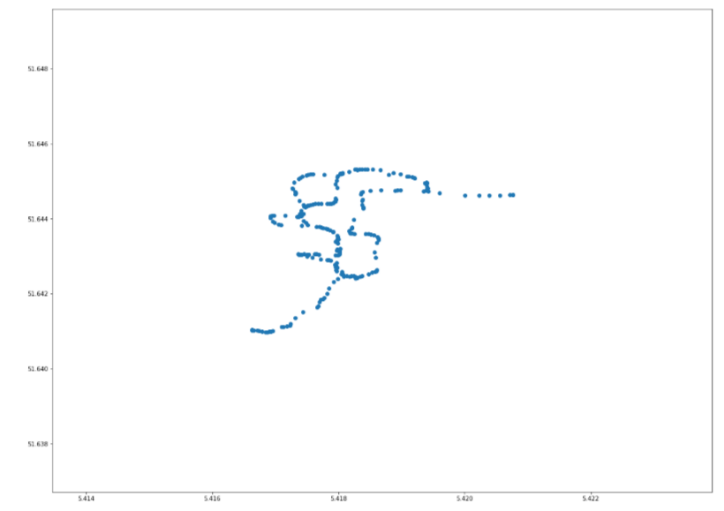
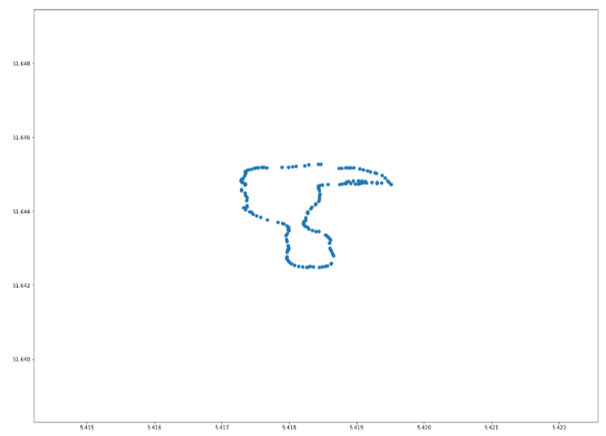
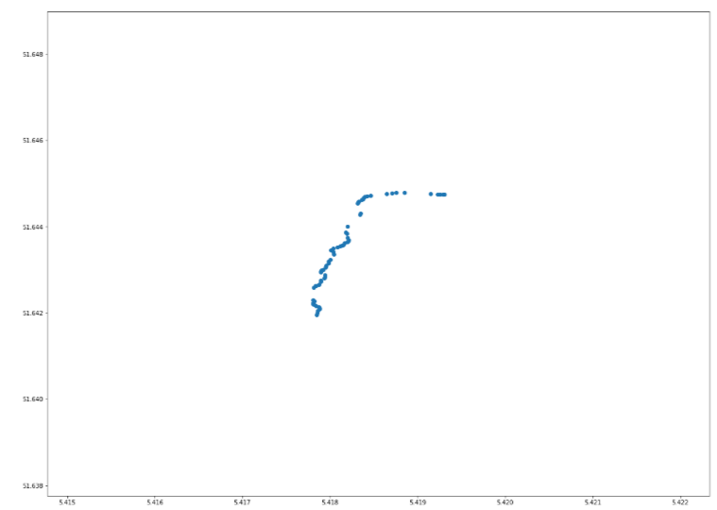
Trace 1
Trace 2
Trace 3
Notes:
Plotted 3 traces, in total we have 18 traces

Slide 3
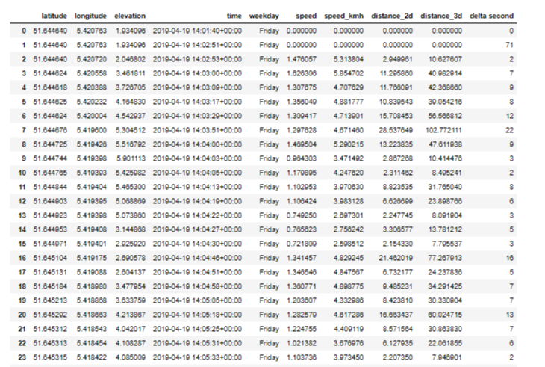
Notes:
Extract features from each trace (above only 1 exemple):
Lat, long, elevation and time;
Weekday;
Speed in m/s;
Speed in km/h;
Distance_2d, distance_3d (3d includes the elevation);
Delta second is the time gap between a gps location and the previous.

Slide 4
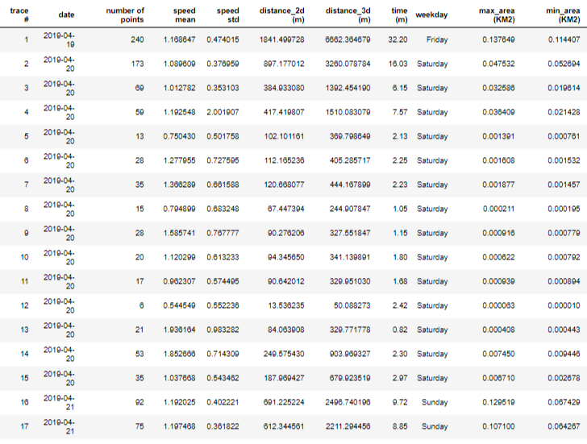
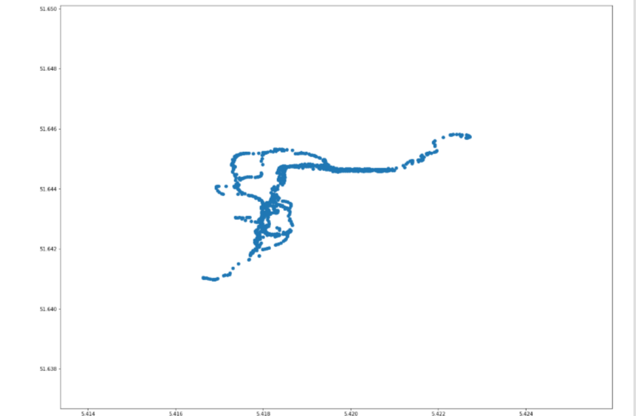
All traces
Notes:
Table overall contains information about all traces:
Date
Number of point recorded
Speed mean (m/s)
Speed std
Distance_2d and distance_3d
Time
Weekday
Max area and min are

Slide 5
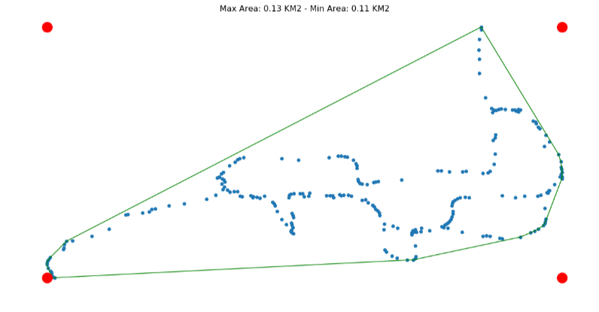
Trace example Max area – Min area
Notes:
Max area is the area contained by the red dot.
Min area is the area within the green lines

Slide 6
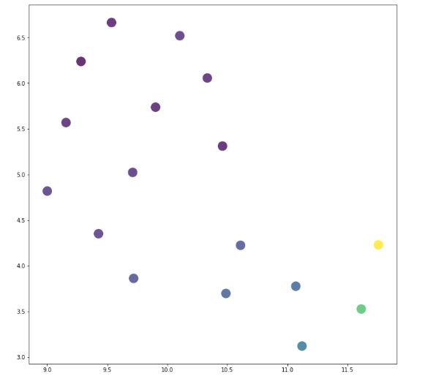
Trace 1
UMAP Dimensionality Reduction
Trace 2
Notes:
Trace number 1 and trace number 2 can be plotted on a 2 dimensional plane

Slide 7
All traces plotted on 2d
Notes:
The position of each trace is not random. A position is given by the feature of each trace, therefore 2 traces closed to each other are likely to have similar features.

Slide 8
Apply clustering
Notes:
Clustering algorithm such as K-mean allows us to extract group of traces that has something in common.

Slide 9
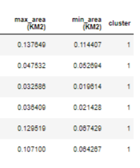
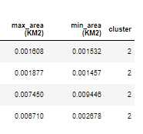
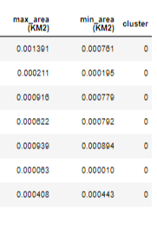
Notes:
In this case k-means divided traced base on the earea, creating 3 groups of traces with similar Max and Min area

